Slide 1
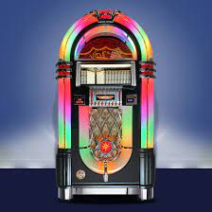
JUKEBOX PROJECT (USING JAVA WITH JDBC)
BY - AJAY KUMAR

Slide 2
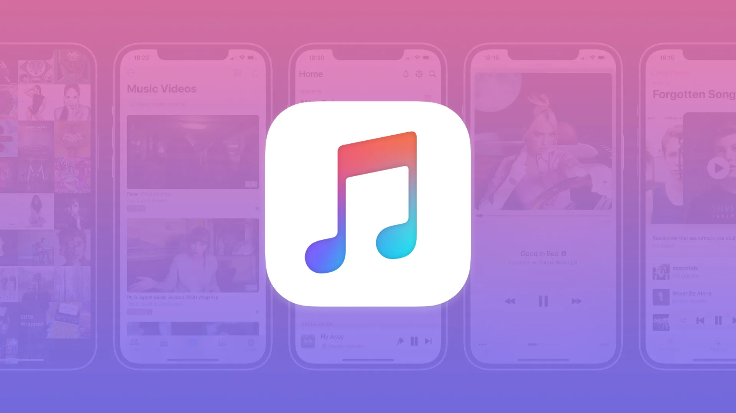
CONTENTS
INTRODUCTION
PROJECT INSIGHT
TECHNOLOGIES USED
JAVA
MySQL
JDBC
ER Diagram
TABLES Structure
PROGRAM FLOW
SQL Queries
JAVA Code (OUTPUT)

Slide 3
INTRODUCTION
A jukebox is a partially automated music playing device, usually a coin operated machine, that will play a patron's selection from self-contained media. The classic jukebox has buttons, with letters and numbers on them, which are used to select a specific record. Some may use compact discs instead. Disc changers are similar devices that are intended for home use, are small enough to fit in a shelf, may hold up to hundreds of discs, and allow discs to be easily removed, replaced, and inserted by the user.

Slide 4
PROJECT INSIGHT
IN THIS JUKEBOX PROJECT, I HAVE MADE AN AUTOMATED JAVA APPLICATION SIMILAR TO OLD JUKEBOX (used for listening music).
FUNCTIONS PROVIDED:-
Listening to Songs
Listening to Podcasts
Creating new account
Login to existing account
Creating customized Playlists
View created playlists & listen from there.

Slide 5
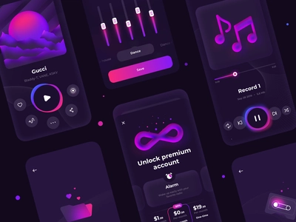
TECHNOLOGIES USED
JAVA
MYSQL
JDBC
SOFTWARE USED :-
IntelliJ – (for java programming)
Mysql Workbench – (for creating Database & tables)

Slide 6
JAVA
Java is a high-level , class- based, oops(object oriented programming system) that is designed to have as few implementation dependencies as possible. It is a general purpose programming language intended to let programmers write once, run anywhere (WORA), meaning that compiled Java code can run on all platforms that support Java without the need to recompile. Java applications are typically compiled to bytecode that can run on any Java Virtual Machine (JVM) regardless of the underlying computer Architecture.
The syntax of Java is similar to C and C++ but has fewer low-level facilities than either of them. The Java runtime provides dynamic capabilities (such as reflection and runtime code modification) that are typically not available in traditional compiled languages. As of 2019, Java was one of the most popular programming languages in use.

Slide 7
MySQL
MySQL is a relational database management system based on the Structured Query Language, which is the popular language for accessing and managing the records in the database. MySQL is open-source and free software under the GNU license. It is supported by Oracle Company.
SQL helps in DBMS(database management system).
It helps to manage data in databases and tabular format.

Slide 8
JDBC
Java Database Connectivity is an application programming interface for the programming language Java, which defines how a client may access a database. It is a Java-based data access technology used for Java database connectivity. It is part of the Java Standard Edition platform, from Oracle.
JDBC helps you to write Java applications that manage these three programming activities: Connect to a data source, like a database. Send queries and update statements to the database. Retrieve and process the results received from the database in answer to your query.
Basically it helps to connect MySQL with java program.

Slide 9
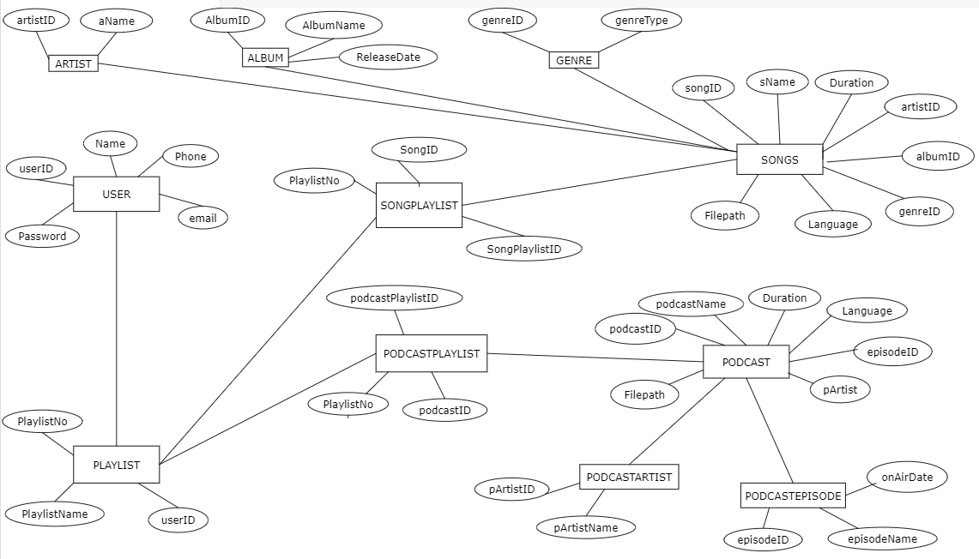
ER - DIAGRAM

Slide 10
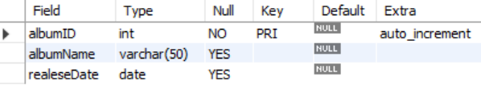


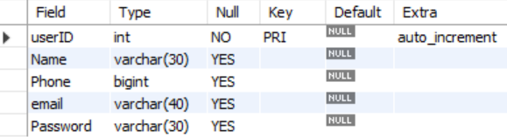
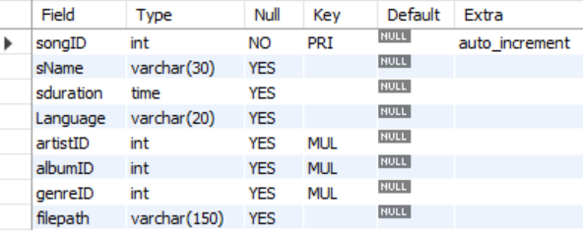
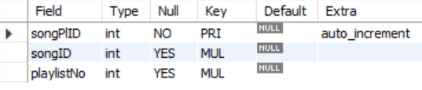
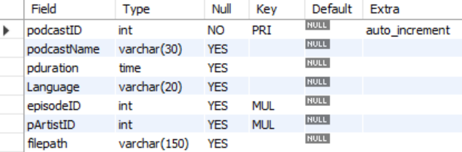
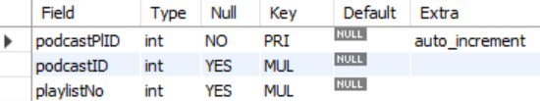
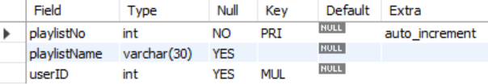
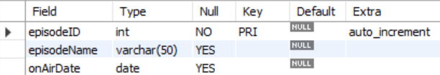

ALBUM
ARTIST
GENRE
USER
SONGS
SONGPLAYLIST
PODCASTS
PODCASTPLAYLIST
PLAYLIST
PODCASTEPISODE
PODCASTARTIST

Slide 11
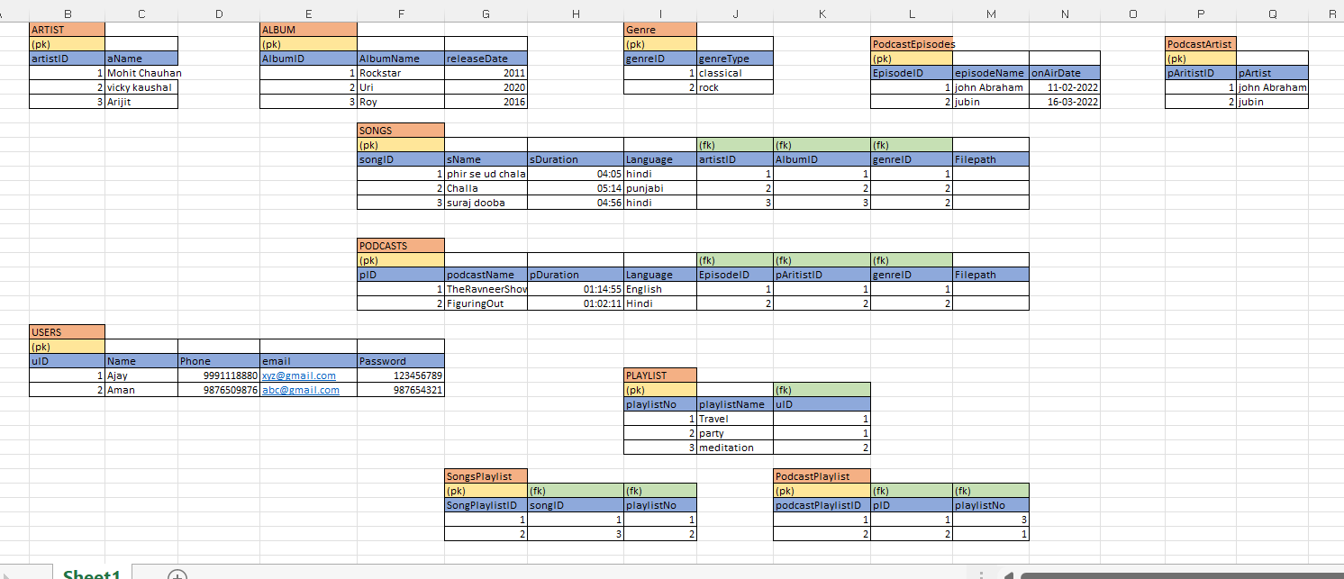
TABLES USED (with some sample entries)

Slide 12
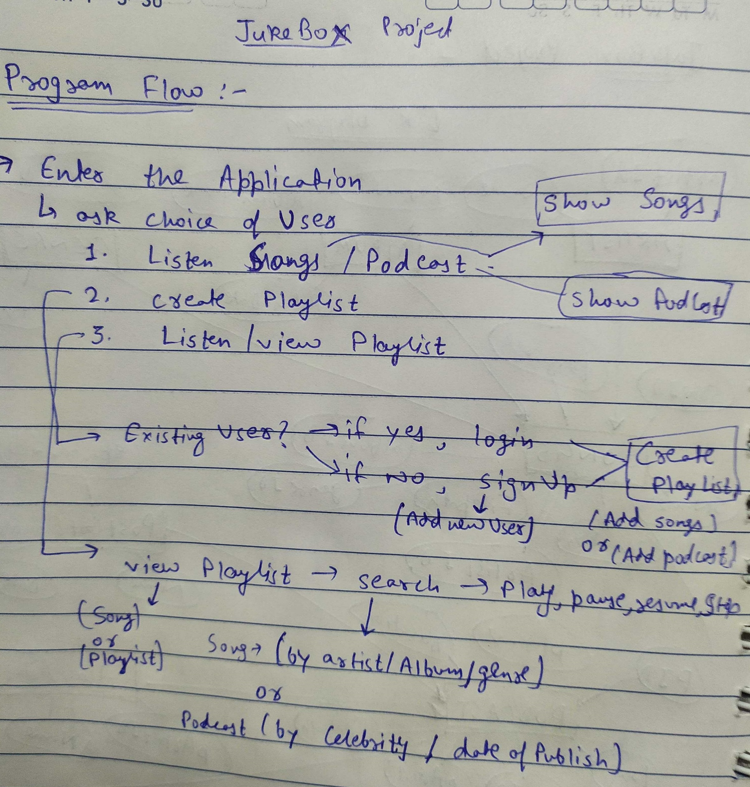
PROGRAM FLOW
User will enter the application
App will give 5 options:-
1 - 'To Listen’ –(Shows songs, podcast & play)
2 - 'To Create your own Playlist’- (login/signup -> create playlist)
3 - 'To view your already created Playlist’-
(login-> view playlist)
4 - 'To search and listen to song/podcast’
-> (shows songs, podcast -> search & play)
5 - 'To close Application’ ->(Exit App.)

Slide 13
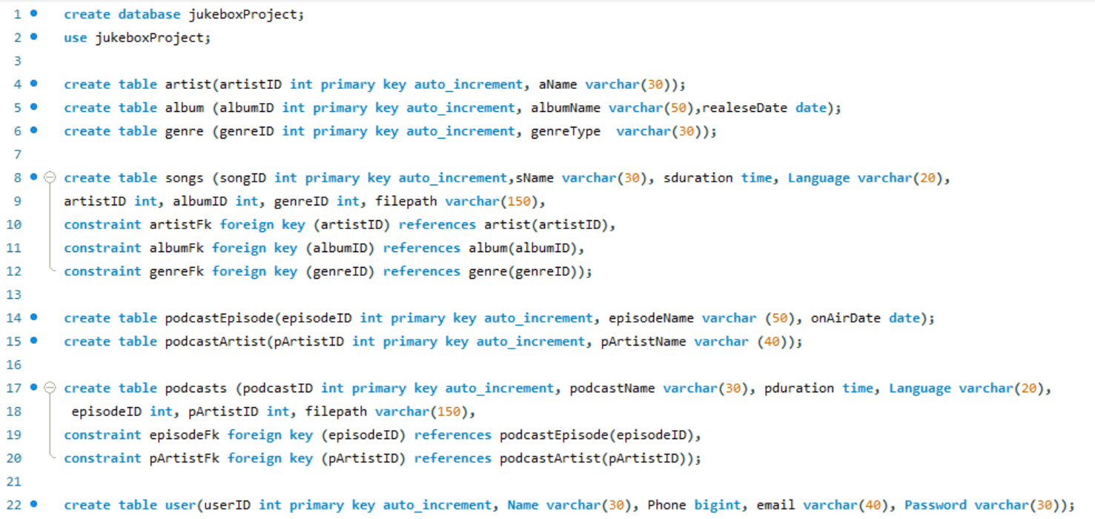
SQL Queries

Slide 14
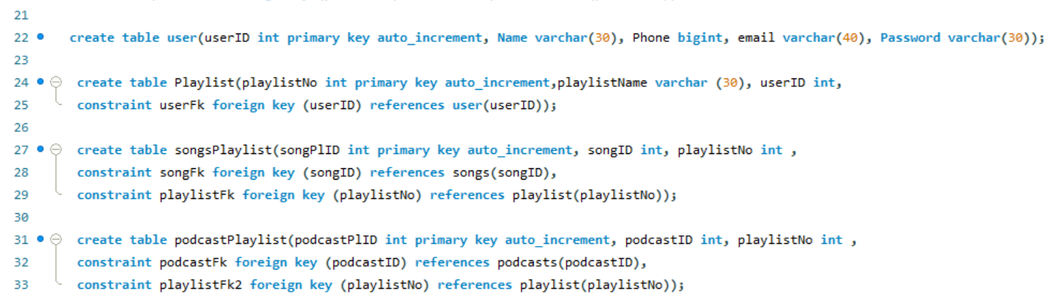
SQL Queries(cont.)

Slide 15
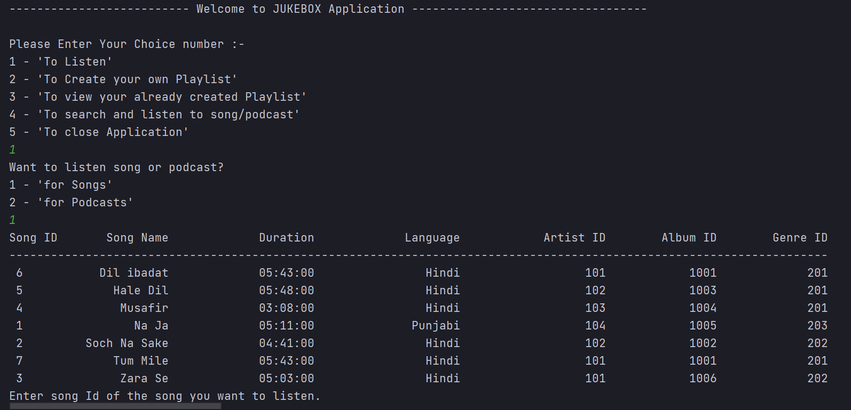
OUTPUT SNAPS

Slide 16
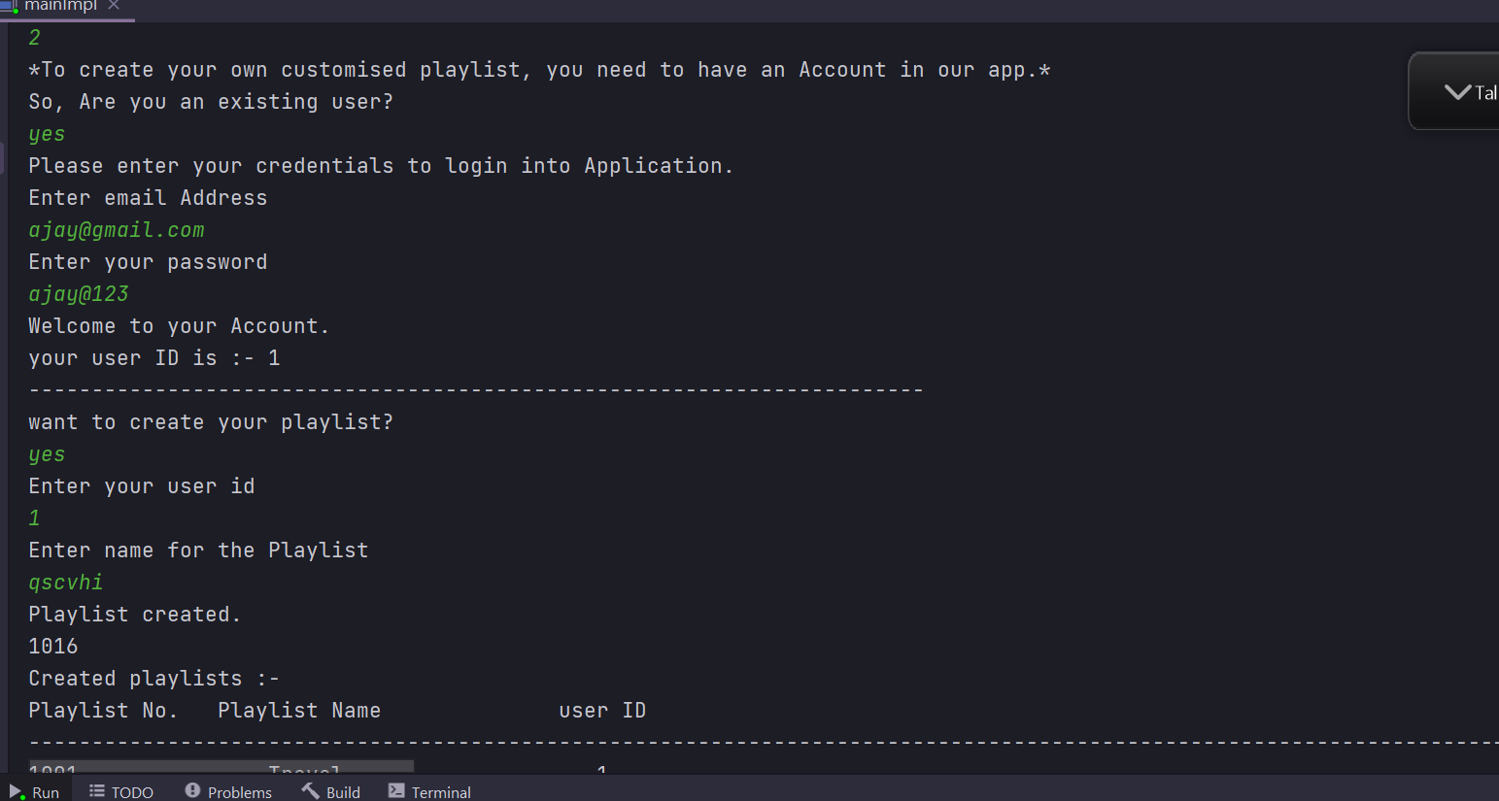
OUTPUT SNAPS

Slide 17
THANK YOU

